Slide 1

LinkedIn Page

Slide 2

Connect to WiFi
Network:
HOBNOB Private
Password:
Perimeter1221 (if that does not work, try 1221Perimeter)
Once connected go to SoHo’s LinkedIn Page

Slide 3

What is SOHO Network?
We are a group of trusted foodservice industry professionals who work together to improve efficiency and profitability.
Our network is composed of over 150 industry members (both restaurant operators and vendors).

Slide 4

What is a LinkedIn Company Page?
It's a free online presence for your organization to build your brand and connect with the LinkedIn community.
It serves as a landing page for potential customers, employees, and followers to learn about your business.

Slide 5
Why do we need a LinkedIn Page?
People buy from who they know
LinkedIn helps to build and create relationships
We want to be a resource to restaurants and each other

Slide 6
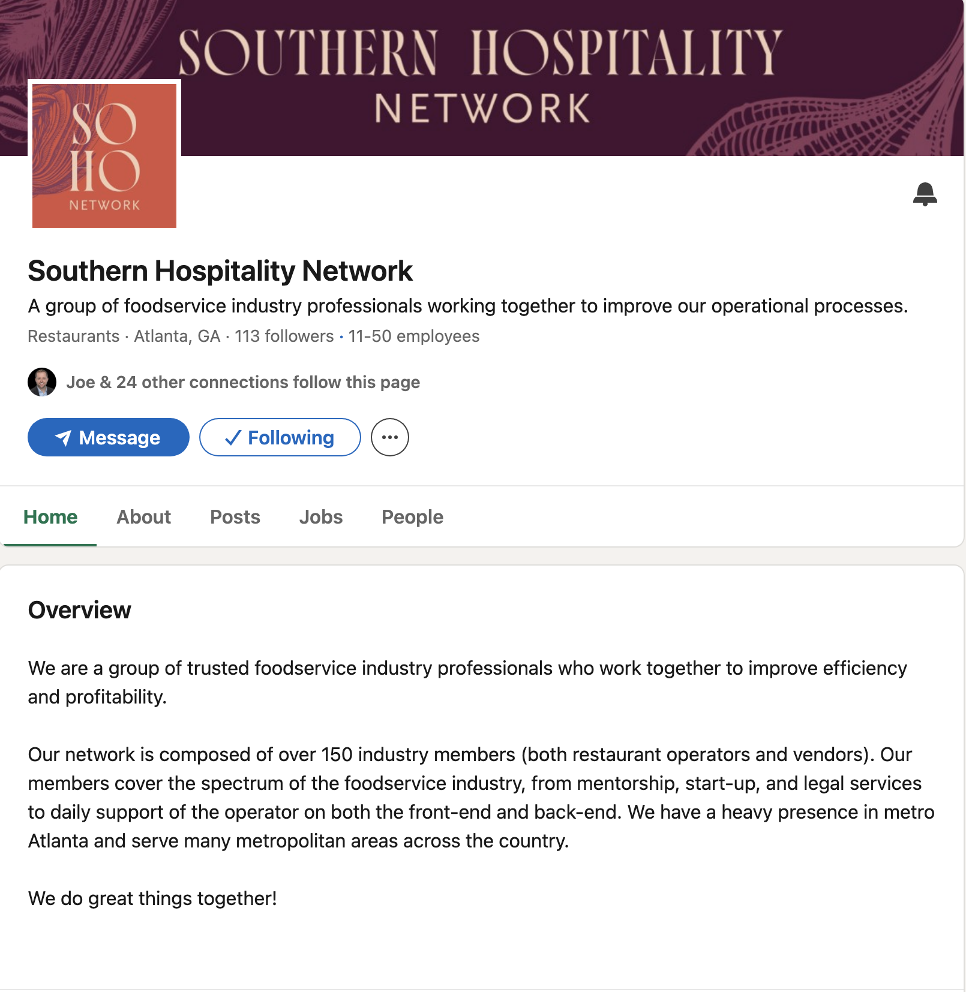

Slide 7
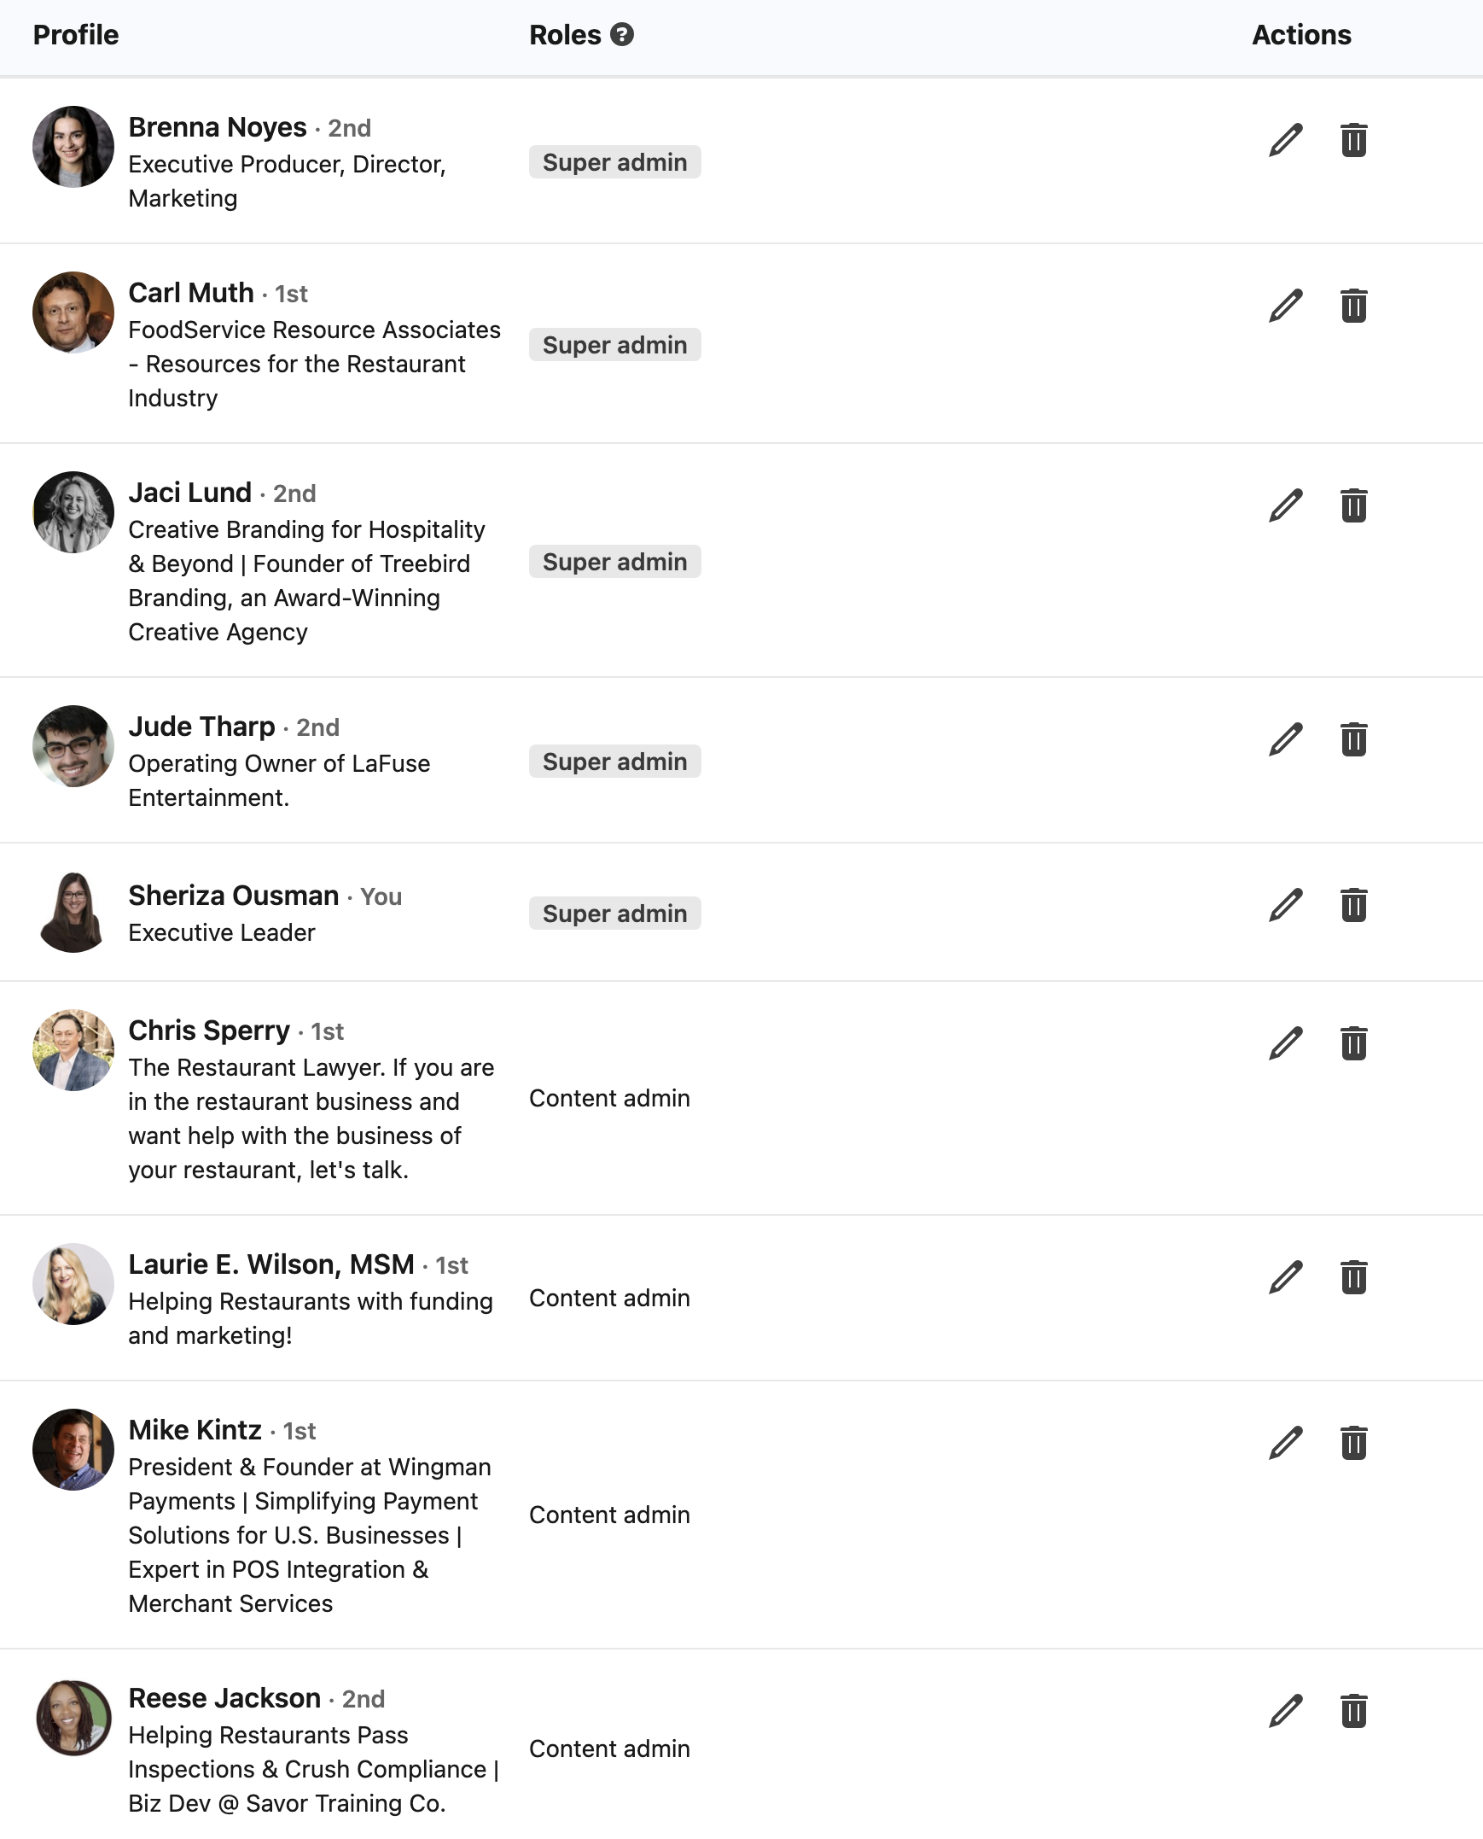
Page Admins

Slide 8
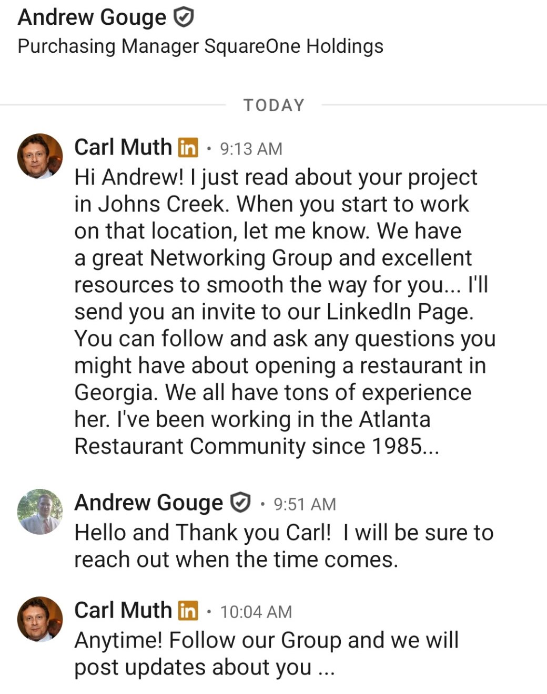

Example of reach out
- Based in TN
- New to Atlanta market

Slide 9


SoHo Network LinkedIn Dos & Don’ts Keeping our feed flavorful, forward-thinking, and always in good taste.
Do:
Celebrate each other
Show off your work (and theirs)
Stay industry-relevant
Think of the audience
Engage with intention
Give credit where it’s due
Support before selling
Use LinkedIn as a professional tool
Don’t:
Don’t get personal or political
Don’t solicit the network
Don’t be a jerk
No arguments on the SoHo page
Don’t post AI-generated fluff
Don’t post without purpose

Slide 10
Content Strategy
Understand target audience: Identify their needs, pain points, and interests to create content that resonates with them.
Vary content formats: Use articles, images, videos, and documents to keep our audience engaged.
Embrace thought leadership: Share industry insights, tips, tutorials, and case studies to establish ourselves as experts. LinkedIn articles and newsletters are effective tools for this.
Post consistently: Maintain a regular posting schedule to build trust and keep our brand visible.

Slide 11
Engage with Audience
Actively participate in discussions: Respond to comments on your posts and engage with content shared by others in your network.
Join and participate in relevant LinkedIn Groups: This is a great way to connect with professionals in our industry, share insights, and find potential prospects.
Personalize our outreach: When sending connection requests or InMail messages, personalize them to make a strong first impression.

Slide 12


A Note on Moderation
The SoHo Network is softly monitored by our admin team. If you see something off-brand, offensive, or just not reflective of the professional, generous spirit we’re building, please flag it privately to an admin. We're here to help keep this space strong and aligned.
At the heart of SoHo is this simple idea: we rise by raising each other. Let’s use LinkedIn to do just that.

